Slide 1
Freelance Session 1
Freelancing on Upwork session
Freelance Sessions

Slide 2
Freelancing Mindset
A lot more money can be made with a quick workflow than with a high price margin
Developer A completes 5 small projects in a day for 500$ each by selecting clients who meet his/her workflow
Developer B completes 1 small project in a day for 1500$ without a workflow
Freelance Sessions

Slide 3
Best practices for Managing big projects
Plan and Prioritize in Azure Task board, Trello or equivalent:
Regular Communication, share your task board with the client:
Testing and QA:
Client Handoff:
Post-launch Support:
Create a project plan, break it into smaller tasks, and set realistic deadlines.
Maintain open communication with the client to keep them informed.
Test your code thoroughly and document it, including a README file.
Provide all necessary files and documentation to the client for project maintenance.
Offer post-launch support for a specified period; 1-3 Months.
Freelance Sessions

Slide 4
Upwork VS. Your Ads
Finding Clients on Upwork
Pros:
Built-in trust and payment protection.
Less marketing effort required.
Cons:
High competition.
Upwork fees reduce earnings.
Finding Clients via Your Ads
Pros:
Potential for higher earnings.
Cons:
Initial marketing effort and cost.
Building trust takes time without platform credibility.
Freelance Sessions

Slide 5
Upwork VS. Your Ads - Process
Upwork Client Acquisition:
Create a profile.
Bid on jobs.
Wait for client selection.
Communicate, work, and get paid.
Clients from Your Own Ads Acquisition:
Set up marketing.
Attract clients.
Communicate, negotiate, and work.
Build relationships and manage payment independently.
Freelance Sessions

Slide 6
Upwork VS. Your Ads - Clients
Finding Clients on Upwork
Pros:
Built-in trust and payment protection.
Wide variety of projects.
Cons:
Clients from Your Ads
Pros:
Targeted client selection.
Cons:
Initial skepticism.
Communication challenges.
Freelance Sessions

Slide 7
Upwork VS. Your Ads – Admin work
Upwork
Upwork handles
Clients from Your Ads
You manage
Flexibility in setting
payments,
contracts,
dispute resolution.
contracts,
payments
terms
policies.
Freelance Sessions

Slide 8
Upwork Connects
You receive 50 connect tokens upon registration with Upwork
Used for bidding on projects – projects require 8 tokens per bid on average
Can bid on 6 projects in first month with free tokens
10 Connect token = Rs 66
1 bid = Rs 66
Connect tokens last 1 year
Freelance Sessions

Slide 9
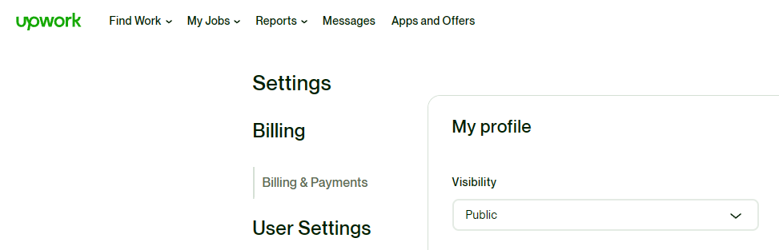
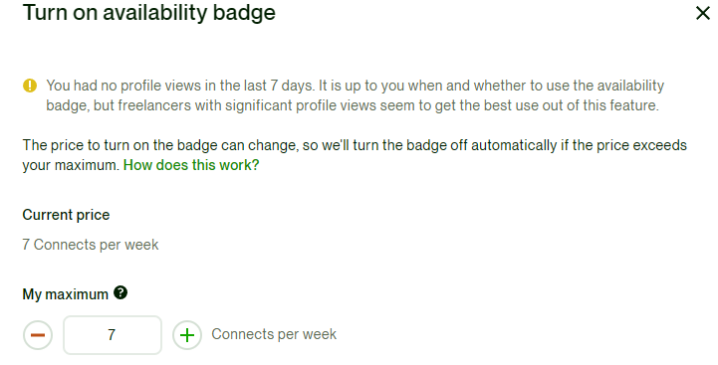
Upwork Tips
Your Upwork profile skills and title need to match your bid
so keep updating your profile with every bid
Set Profile visibility as Public
Turn on availability on minimum connects/week
Add a profile video based on your CV
Be ID verified
Reply client’s queries in less than 24h on Upwork
Offer additional services to your client after a project with them
Freelance Sessions

Slide 10
Upwork Tips
Add non-Upwork testimonials on Upwork,
send testimonials requests from Upwork to your client’s email
Everyday, search jobs on Upwork which
Filter by fewest bids and apply to them
perfectly match your skillset,
Freelance Sessions

Slide 11
Upwork Tips
When you start, you need to get into 3-5 small projects with fewest bidders
to have good ratings on your Upwork profile
to get familiar with working freelance
to build your portfolio and reputation
Write a good cover letter and include your portfolio website linked to Upwork, when applying to an Upwork job
Once you get selected and finally talk to the client, screen your employer to
see if you can work with them
Freelance Sessions

Slide 12
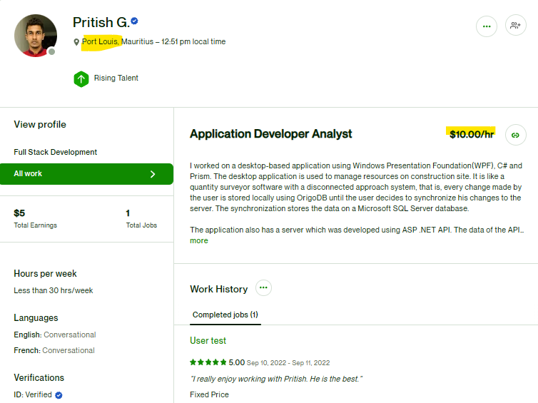
Mauritius Freelance Web devs – Hourly Rate
$10/hr
Freelance Sessions

Slide 13
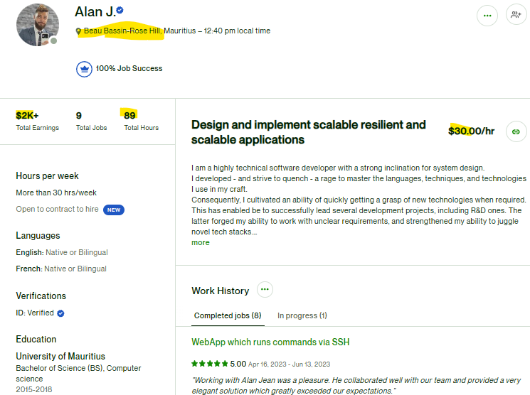
Mauritius Freelance Web devs – Hourly Rate
$30/hr
Freelance Sessions

Slide 14
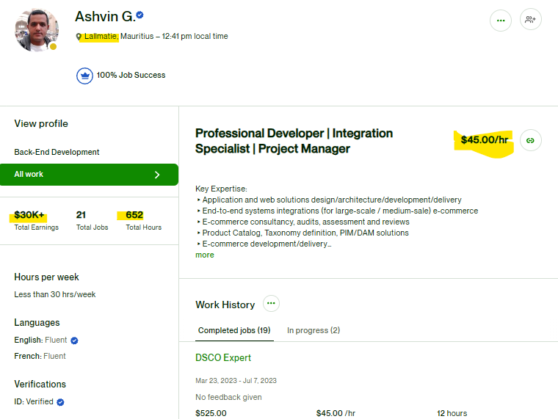
Mauritius Freelance Web devs – Hourly Rate
$45/hr
Freelance Sessions

Slide 15
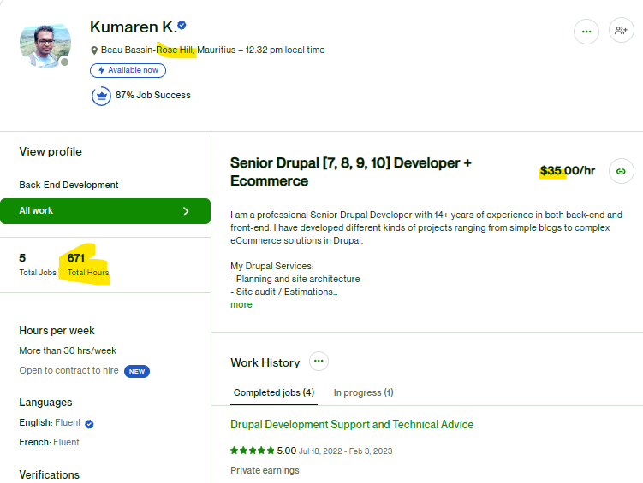
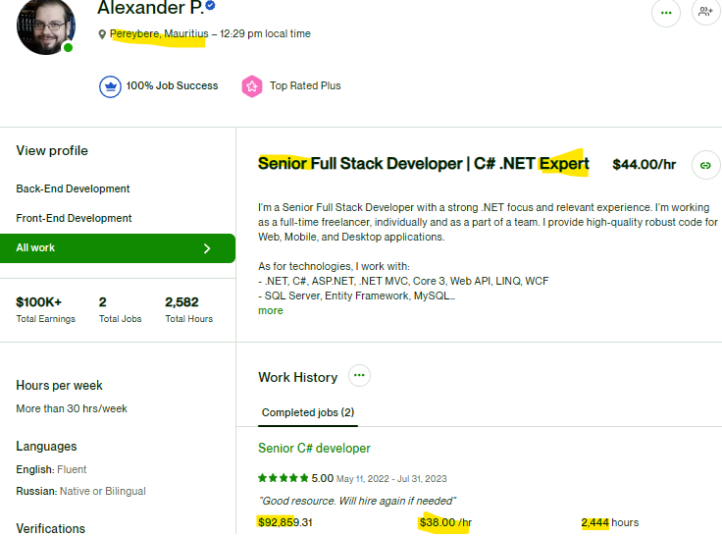
Mauritius Freelance Web devs – Hourly Rate $35/hr - $44/hr
Freelance Sessions

Slide 16
Upwork jobs to avoid:
Clients that has not been verified
Clients with bad reviews on Upwork
Clients with unrealistic expectations
Jobs where the client has no activity
on the posting for 1+ week
for budget to work ratio
for payment/ID
How to Get Your First Job on Upwork (FAST!) Step by Step Tutorial for Beginners 2023 - YouTube
Freelance Sessions

Slide 17
Upwork Cover letter template with Action Item
— Cover Letter Introduction — Hi [insert name of client]!
Thank you so much for providing detailed information about your job. It instantly grabbed my attention and aligns perfectly with my experience as a [insert your job title].
— Provide an example of your work —
As you can view on my Upwork profile, I’ve completed numerous [insert job title] jobs with 5-star reviews, including overly positive client feedback. Two specific examples that showcase the quality of my work and relate directly to your job post are attached to this proposal for you.
— Prove your credibility — Here’s what you should know about me: [List your best accomplishments, qualifications, and anything that makes you stand out among the crowd]
— List what you can bring to the project — Here’s what I can bring to your project: [Read over the job description again and tell the client how you can benefit their project]
— Include a call to action —
Let’s schedule a quick 10-minute introduction call so that we can discuss your project in more detail and ensure that I will be the perfect fit. I have tomorrow open from [insert available times].
If those times don’t work for you, just let me know what works best and I will do my best to alter my schedule around your availability.
Questions for the call:
[Insert question] [Insert question] [Insert question]
— Closing —
Best Regards,
[Your Name]
How to Get Your First Job on Upwork (FAST!) Step by Step Tutorial for Beginners 2023 - YouTube
Freelance Sessions
Upwork Cover Letter Template (notion.site)

Slide 18
Upwork Interview
Happens on Upwork’s platform
Dress formally and have a quiet well lit environment
Get a good webcam from Ebay or Amazon
Keep your proposal side by side
when doing the interview such that you can elaborate on it
and give any evidance required to back up your claims from that proposal
How to Get Your First Job on Upwork (FAST!) Step by Step Tutorial for Beginners 2023 - YouTube
Freelance Sessions
Upwork Cover Letter Template (notion.site)

